Slide 1




Adaptive Web Design

Slide 2
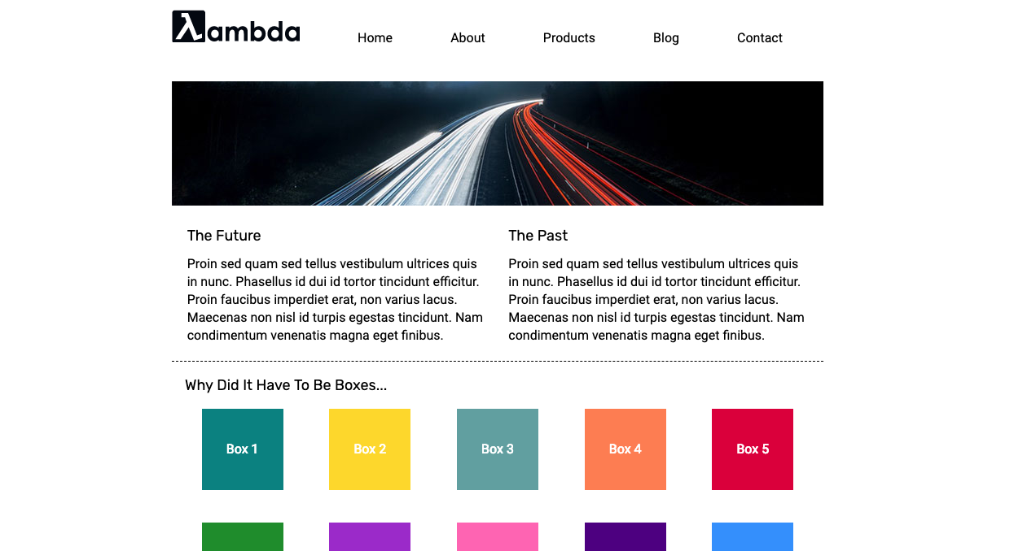
Adaptive Web Design

Slide 3


